Slide 1
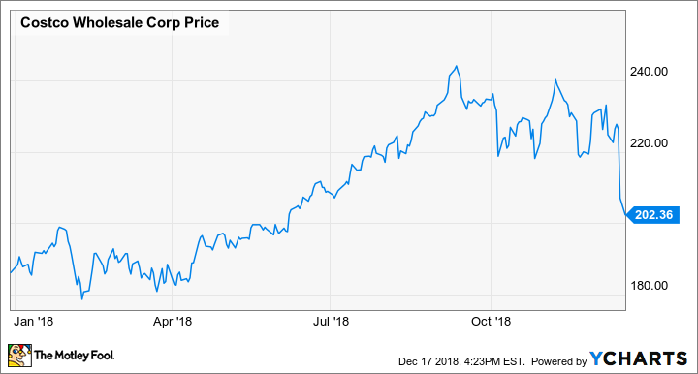
Closing Stock Price Prediction Using Regression
GAYATRI & RITI

Slide 2
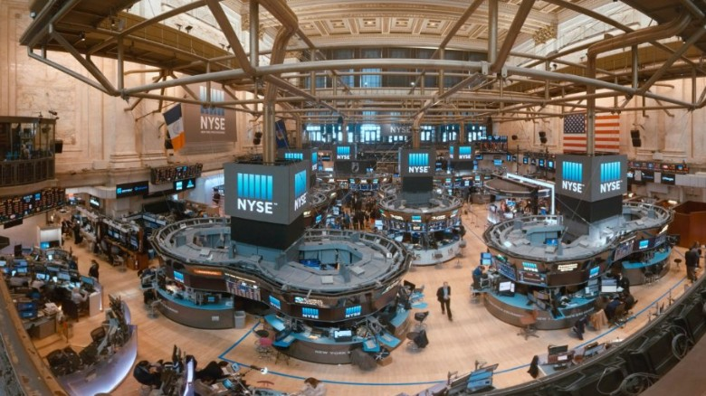
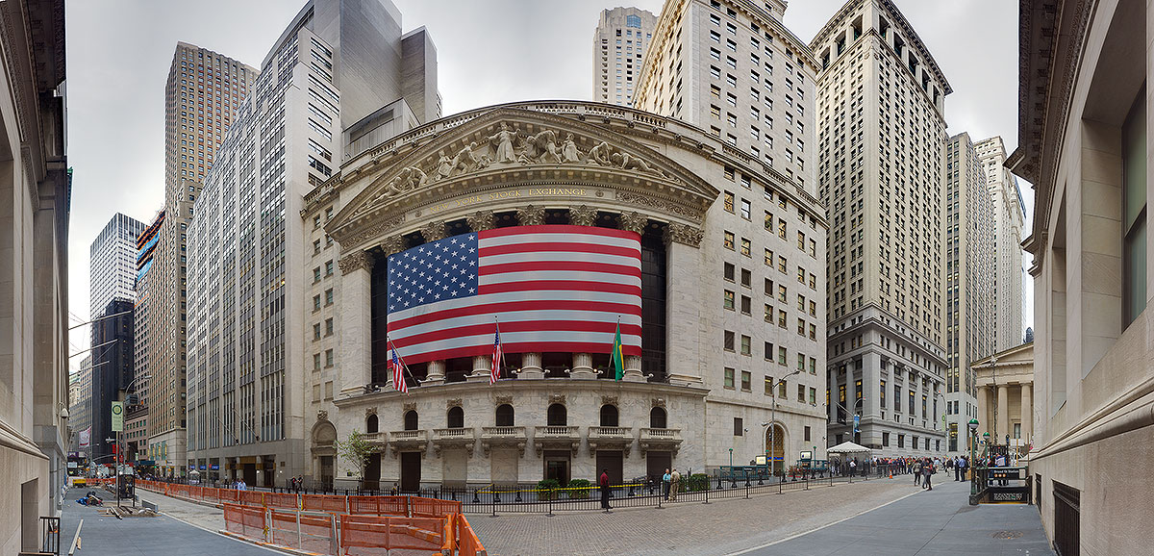
Agenda
Introduction
Features determining close price
The Stock Market Dataset
Exploratory Data Analysis
Data Cleaning & Normalization
Regression Models used
Results
Conclusion

Slide 3
Introduction
Stock prices rise and fall with change in fraction of time. Probabilistic and statistical analysis of stock market can help investors to invest their money wisely for a particular stock.
If there is a possible approach that can be followed to predict the trend of price rise or fall in a stock, it can be used to give a technical analysis for stock market data.
The Open-High-Low-Close chart is used to understand the trend of the stock market and get high, low and closing prices of stock.
Artificial Intelligence helps in doing the complex mathematical manual predictions on stock market data smartly and in real-time.

Slide 4
Features Determining the Closing Price of a Stock
Features that contribute in predicting the closing price of a particular stock are as follows:
Open Price
Low Price
High Price
Volume
Adjusted Open Price
Adjusted High Price
Adjusted Low Price
Adjusted Volume
The predictor models are trained and tested using Walt Disney Stock price dataset available on quandl.

Slide 5
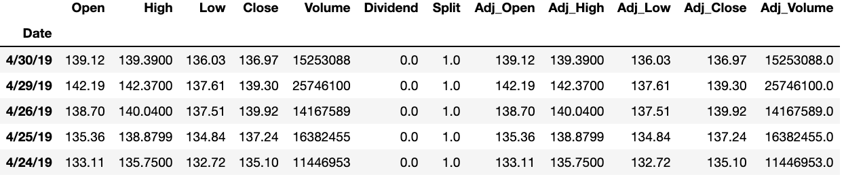
The Stock Market Dataset
The Closing price of Walt Disney stock is calculated using the End-of-Day(EOD) stock data downloaded from the Quandl website.
The dataset consists of 10000+ rows containing information about stock prices and 10 columns describing the features.
The dataset contains values ranging from the year 1962 to 2019.
Following is a snippet of dataset used for prediction of closing stock price:

Slide 6
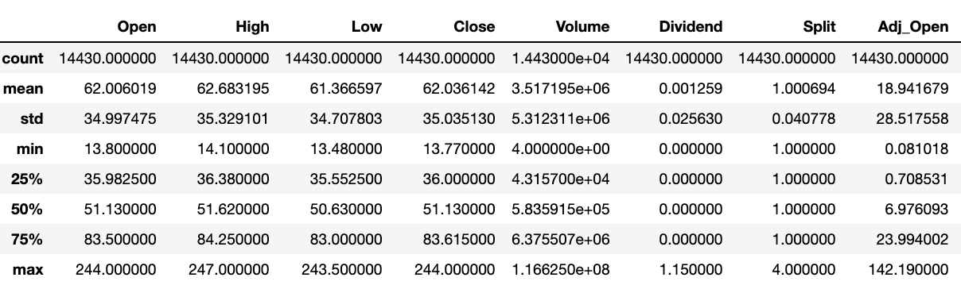
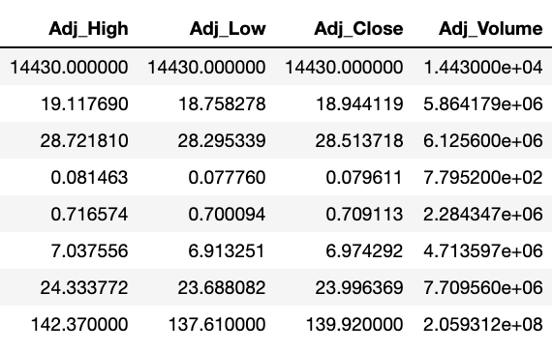
Exploratory Data Analysis
Summary Statistics:
Statistics helps in understanding the distribution of data.
It also helps in understanding the common rise and fall of the stock prices.
It serves as an evidence to investors that a company is growing and it is safe to invest.
Following is snippet of summary statistics:

Slide 7
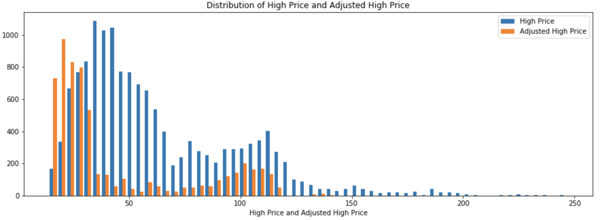
Exploratory Data Analysis
Data Visualization:
To understand various dimensions of the data, the data visualization using histogram is done as follows:

Slide 8
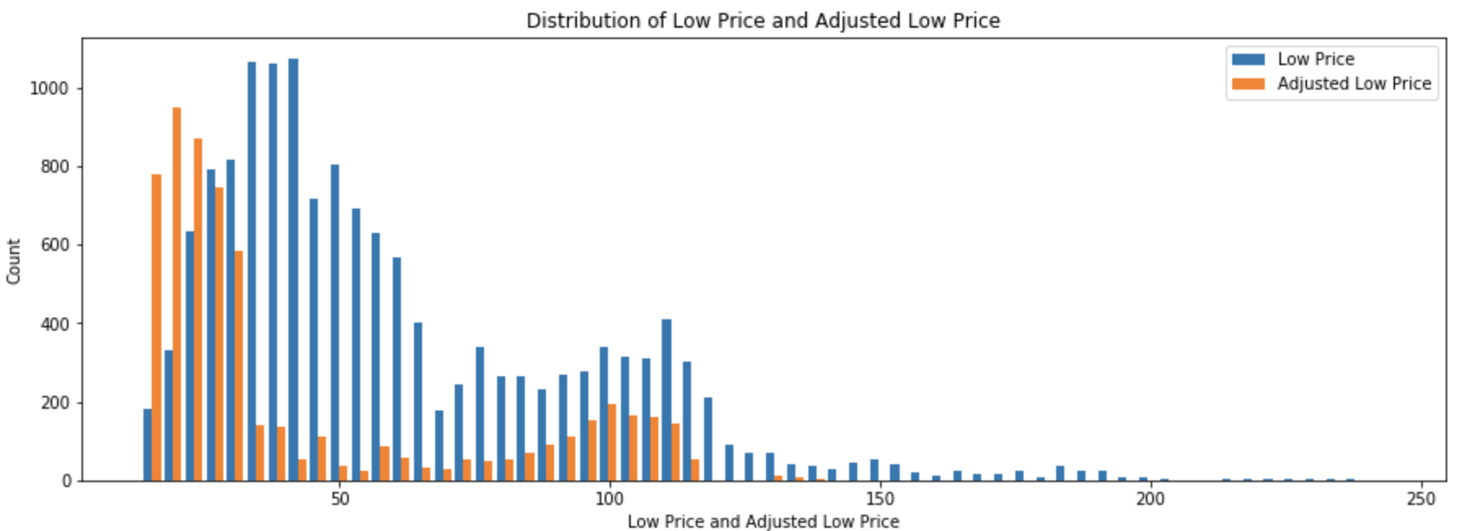
Exploratory Data Analysis
Data Visualization:
The plot of variations in price ranges between the low price and adjusted low prices is as shown below:

Slide 9
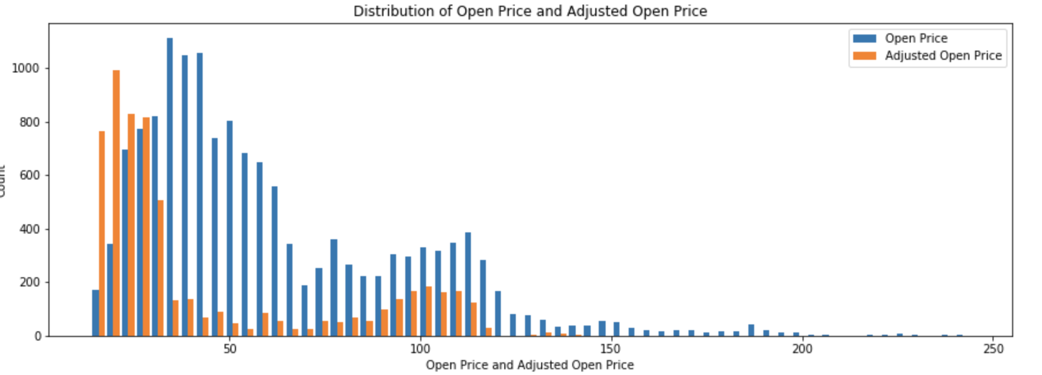
Exploratory Data Analysis
Data Visualization:
The plot of variations in price ranges between the Open price and adjusted Open prices is as shown below:

Slide 10
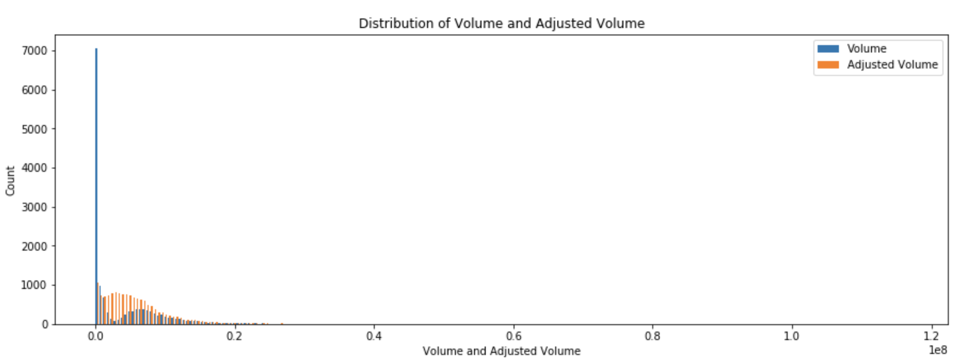
Exploratory Data Analysis
Data Visualization:
The plot of variations in price ranges between the Volume and adjusted Volume is as shown below:

Slide 11
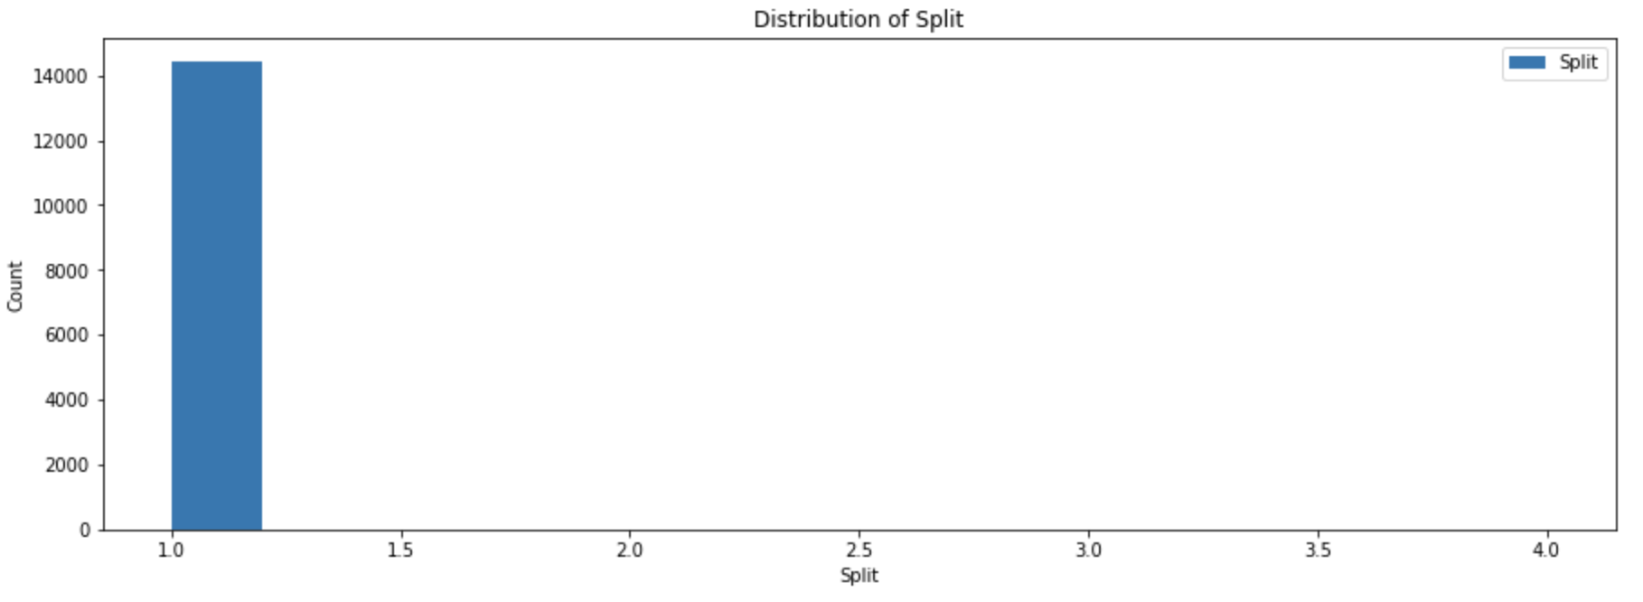
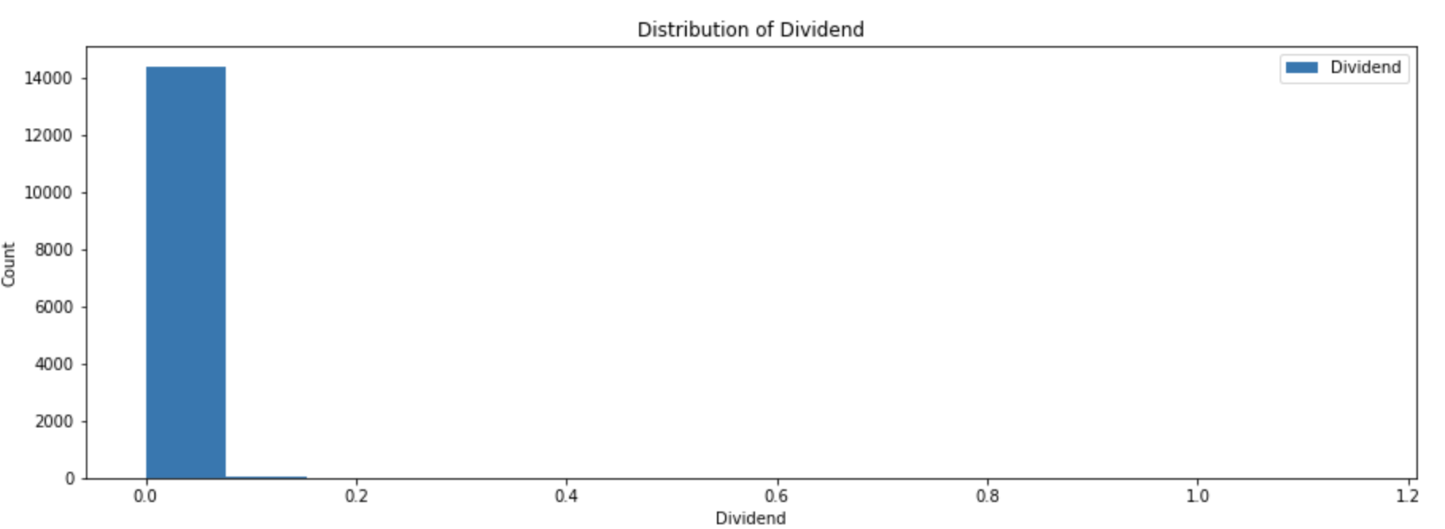
Exploratory Data Analysis
Data Visualization:
The plot of variations in Split and Dividend is as follows:

Slide 12
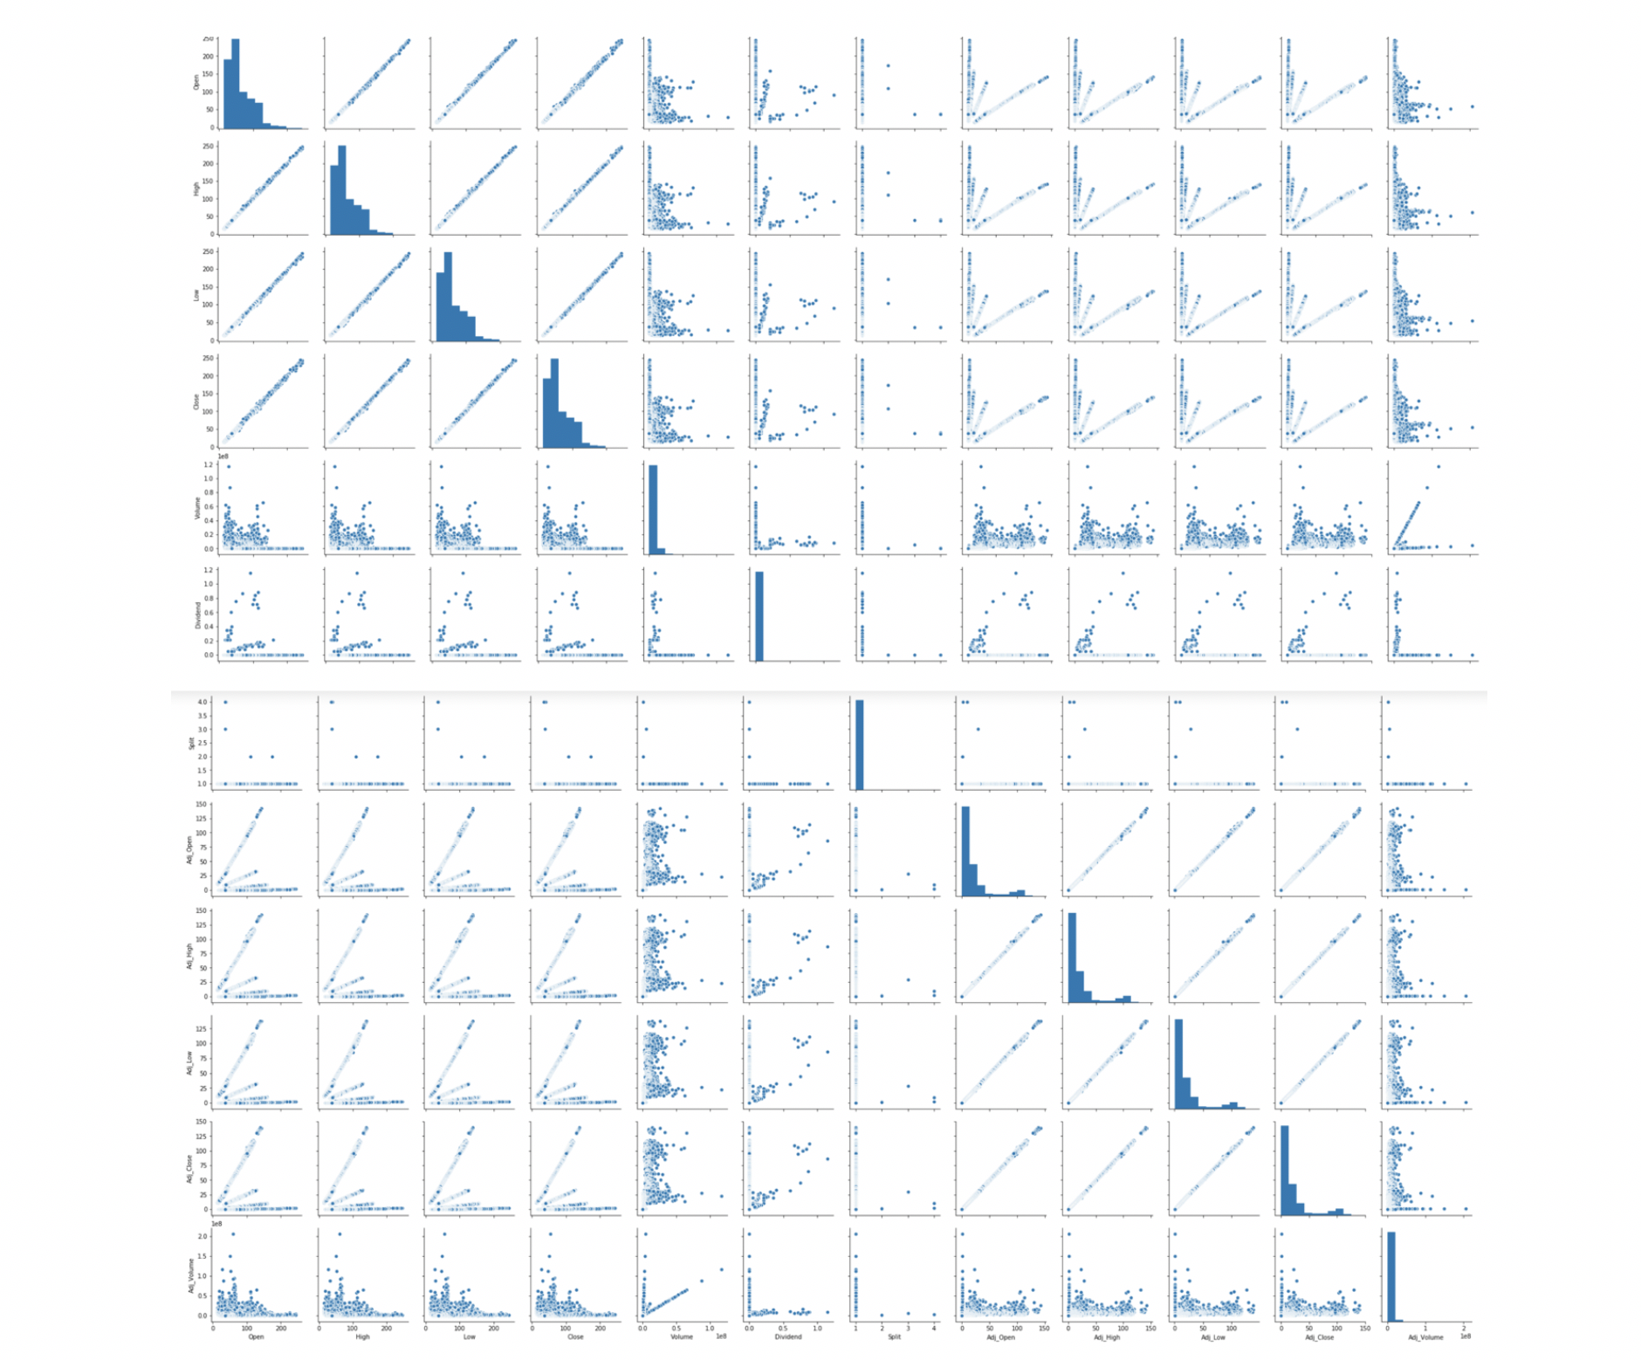
Exploratory Data Analysis
PairPlot
The plot of variations in multi dimensional stock dataset is as follows:

Slide 13
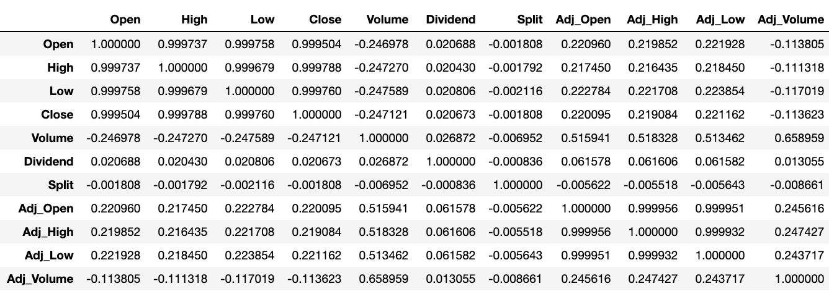
Exploratory Data Analysis
Correlation Matrix:
The correlation matrix for Walt Disney Stock dataset is plotted as follows:

Slide 14
Dataset Cleaning & Normalization
If the data used is unclean or contains noise, this might lead to wrong prediction.
The impact of predicting wrong value for a stock price will lead to loss of millions of dollars and can spike or bring down a value of currency.
Dataset cleaning and finding null values is important to avoid inconsistency in data prediction.
Since the ranges of values for features like open, high, low and volume are different, the data needs to be normalized before it is used for training.
Dataset is cleaned by removing the null values and Z-score normalization is used in this project to normalize data

Slide 15
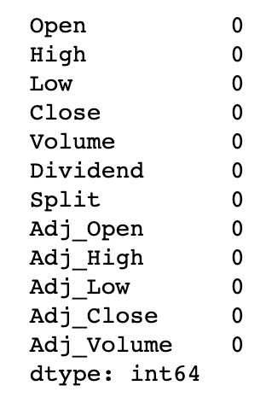
Data Cleaning
Following is the snapshot of the dataset summary showing no presence of NULL values:

Slide 16
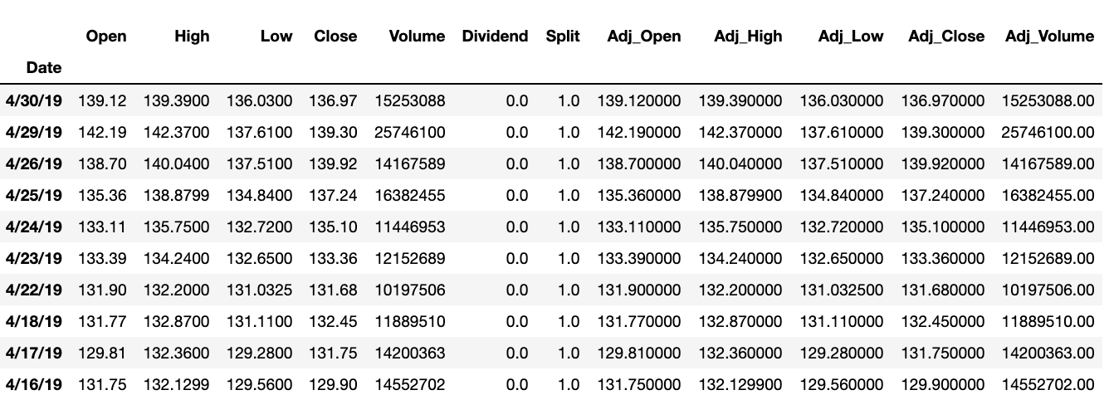
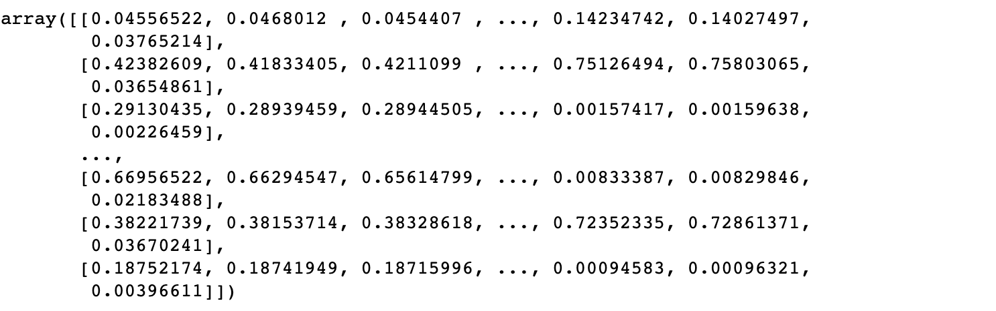
Dataset Normalization
Following is the snapshot of the dataset before normalization:
Following is the snapshot of the dataset after normalization:

Slide 17
Regression Techniques Used
Random Forest Regressor
ADA Boost Regressor
Linear Regression
Decision Tree Regression

Slide 18
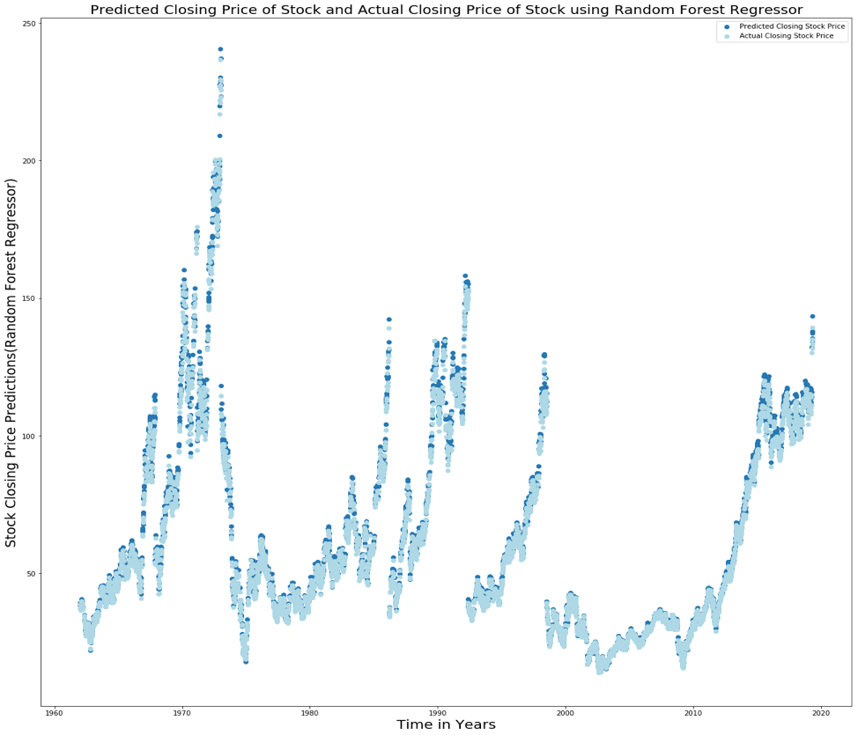
Results: Random Forest Regressor
MSE: 2.66
R2 score: 0.9979

Slide 19
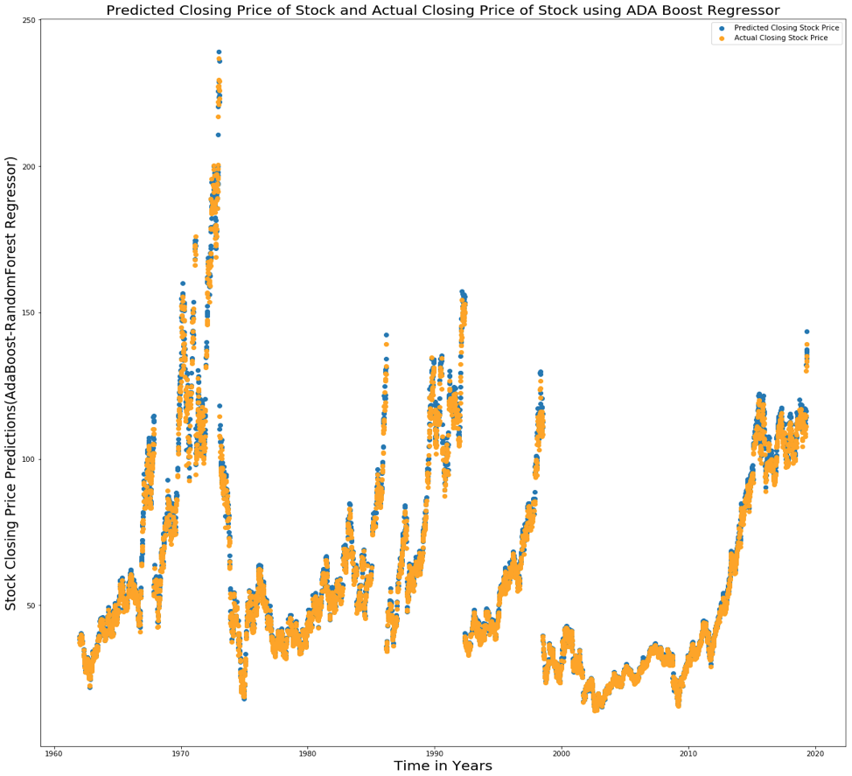
Results: ADA Boost Regressor
MSE: 2.57
R2 score: 0.9980

Slide 20
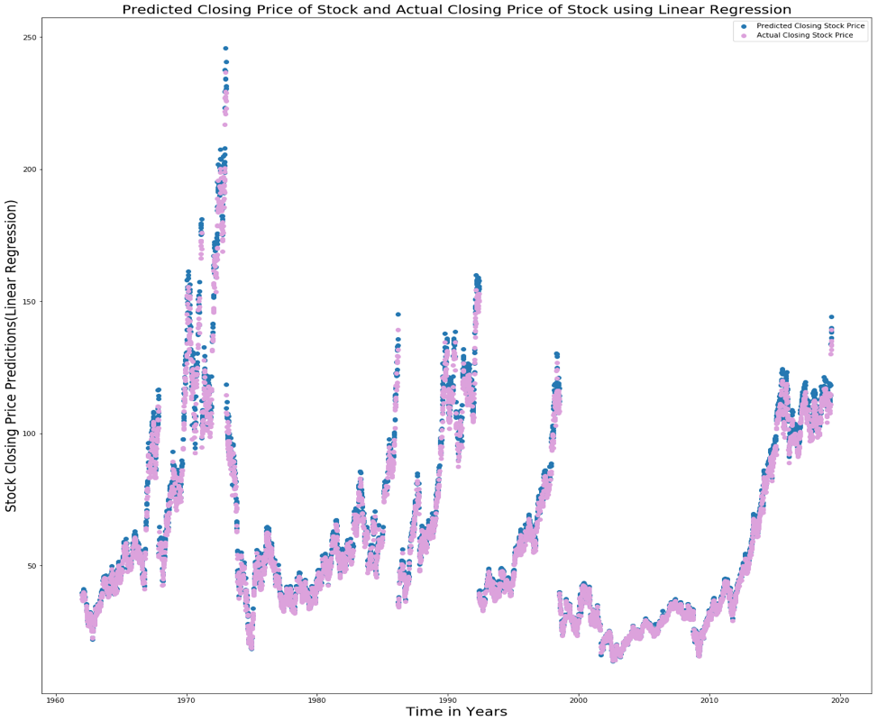
Results: Linear Regressor
MSE: 5.80
R2 score: 0.9955

Slide 21
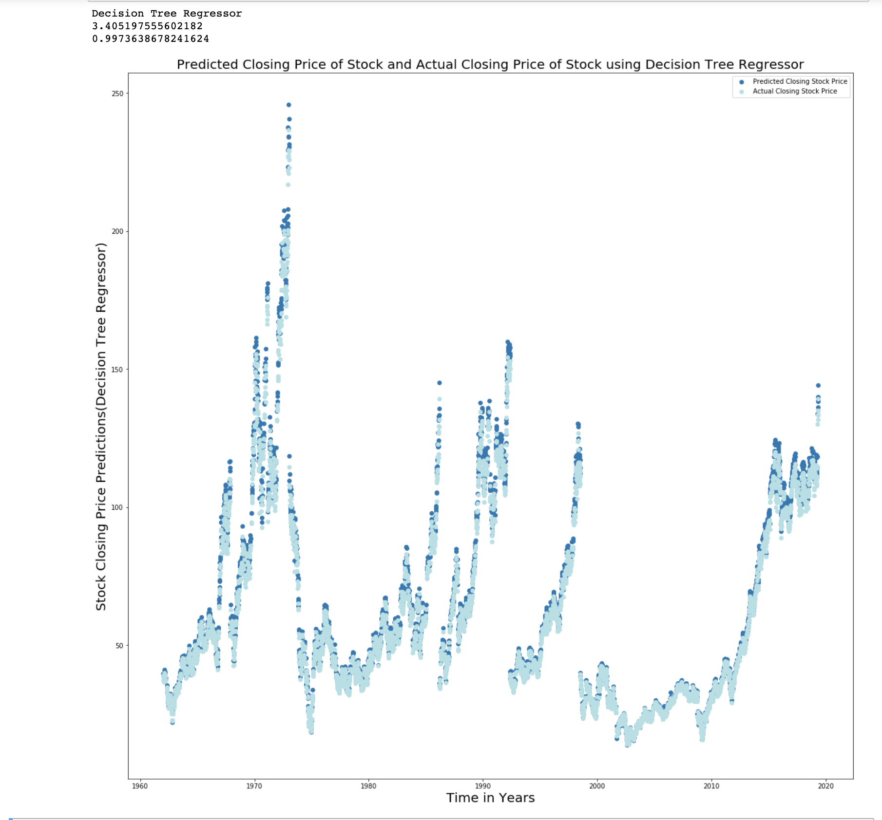
Results: Decision Tree Regressor
MSE: 3.40
R2 score: 0.9973

Slide 22
Performance Evaluation Metrics Used
Metrics used for performance evaluation are as follows:
Mean Squared Error
R2 Score

Slide 23
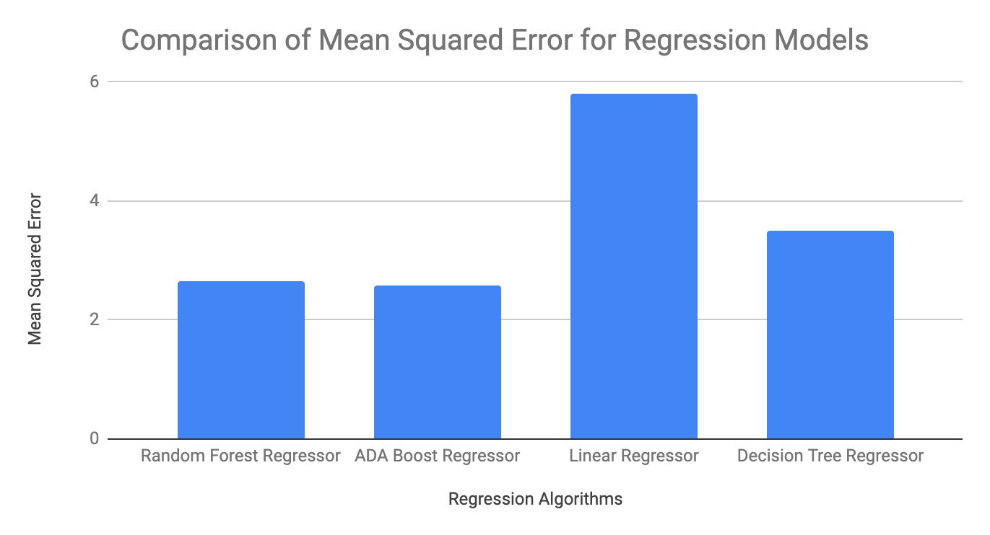
Comparison of Mean Squared Error

Slide 24
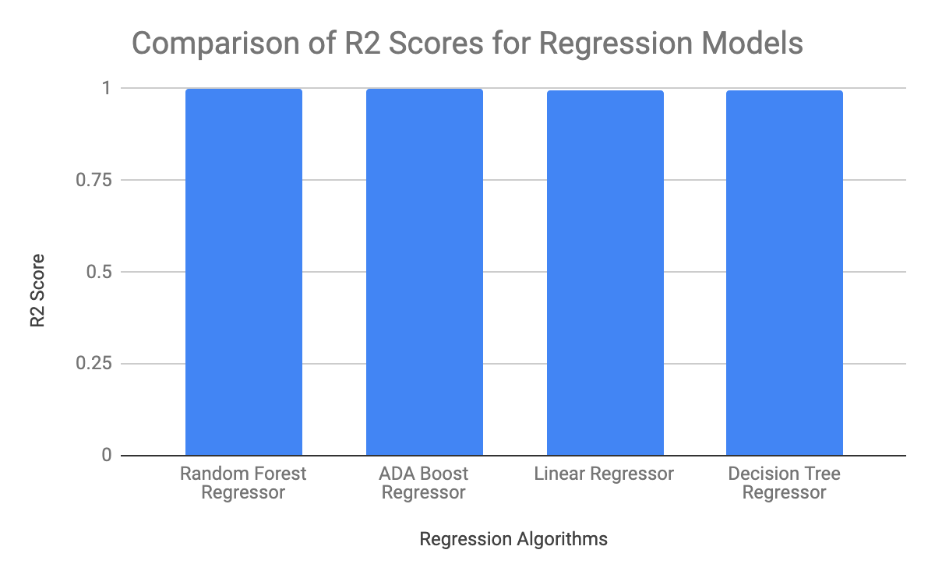
Comparison of R2 Score

Slide 25
Conclusion
As per the models used and performance metrics used, ADA boost regressor tunes the performance and increases the accuracy of random forest regressor.
The decision tree regressor performs better in predicting the stock price as compared to linear regressor.
The ADA boost regressor is the best model to predict closing price of stock for the Walt Disney stock dataset.

Slide 26
THANK YOU

